Slide 1
NETWORK ANALYSIS TOOL ANALYZING GRAPH STRUCTURES WITH BFS AND DFS

Slide 2
OBJECTIVES:
Implement BFS and DFS Algorithms: The primary objective is to implement the BFS and DFS algorithms to traverse the graph from a given starting node to explore its neighboring nodes.
Find Shortest Path using BFS: Utilize the BFS algorithm to find the shortest path between two nodes in the graph. This objective involves extending the BFS traversal to keep track of the path from the starting node to the destination node.
Visualize Graph Traversal: Integrate visualization capabilities to dynamically illustrate the traversal process of both BFS and DFS algorithms on the graph. Visualization aids in understanding the algorithm's behavior and the structure of the graph.
Highlight Visited Nodes: During the traversal, highlight the nodes that have been visited to provide visual feedback on the progress of the algorithm. This objective enhances the clarity of the visualization and facilitates understanding.

Slide 3
Demonstrate Graph Layout:
Utilize NetworkX's spring layout algorithm to position the nodes of the graph in a visually appealing manner. The objective is to present the graph in a clear and organized layout that aids in visualization.
Pause Visualization for Clarity:
Incorporate pauses in the visualization process to allow users to observe each step of the traversal algorithm. Pausing the visualization provides users with time to comprehend the traversal process and the changes occurring in the graph.
Provide Detailed Outputs:
Print the visited nodes during BFS and DFS traversals, as well as the shortest path found using BFS. Detailed outputs help users understand the algorithm's behavior and verify the correctness of the traversal and path-finding processes.

Slide 4
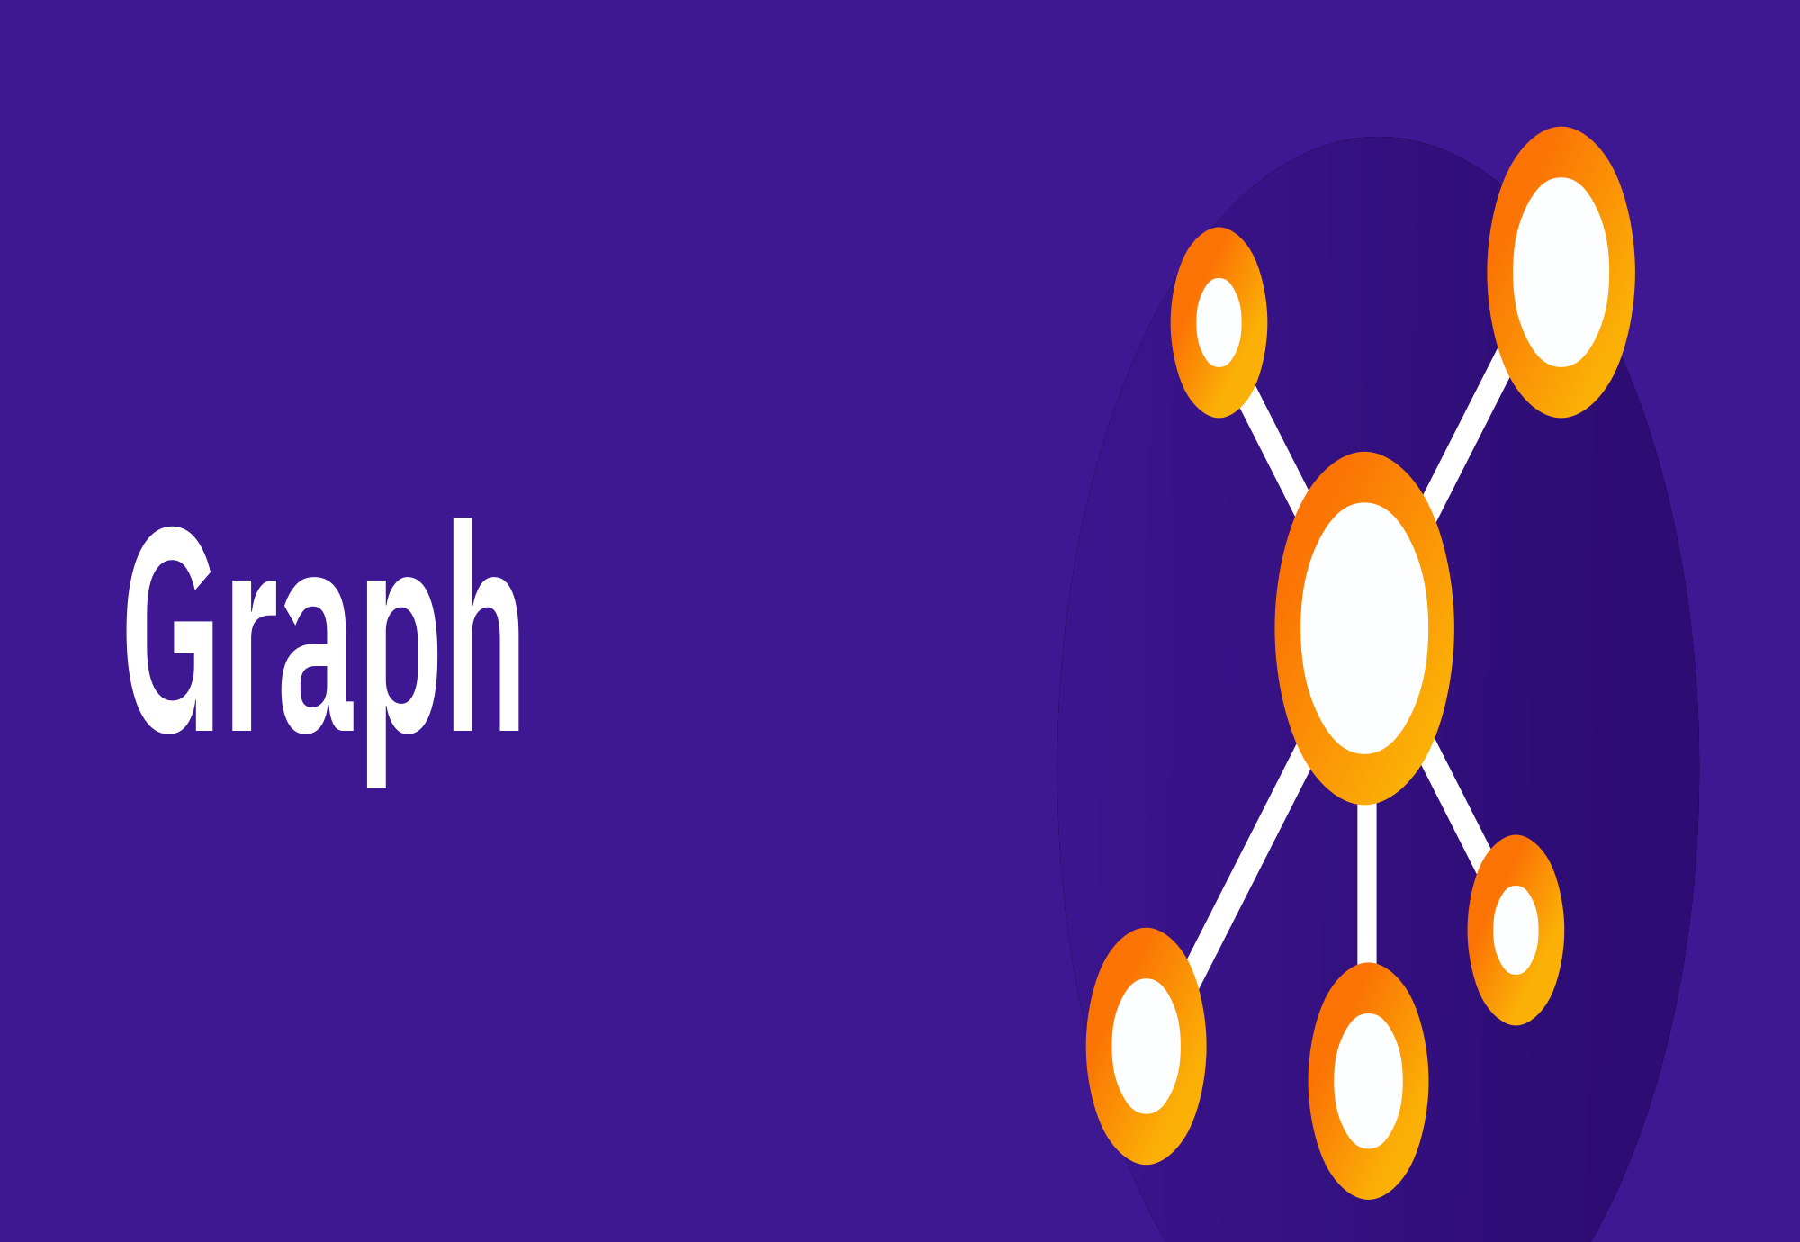

Slide 5
GRAPH INTRODUCTION
A Graph is a non-linear data structure consisting of vertices and edges. The vertices are sometimes also referred to as nodes and the edges are lines or arcs that connect any two nodes in the graph. More formally a Graph is composed of a set of vertices( V ) and a set of edges( E ). The graph is denoted by G(V, E).
Graph data structures are a powerful tool for representing and analyzing complex relationships between objects or entities. They are particularly useful in fields such as social network analysis, recommendation systems, and computer networks

Slide 6
In the field of sports data science, graph data structures can be used to analyze and understand the dynamics of team performance and player interactions on the field.
Imagine a game of football as a web of connections, where players are the nodes and their interactions on the field are the edges. This web of connections is exactly what a graph data structure represents, and it’s the key to unlocking insights into team performance and player dynamics in sports.

Slide 7
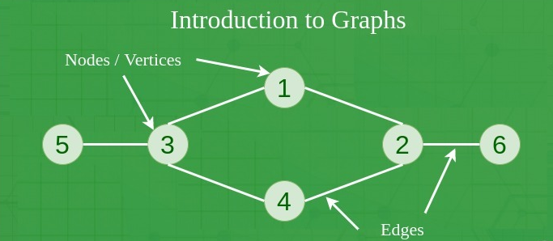

Slide 8
COMPONENTS OF A GRAPH
Vertices: Vertices are the fundamental units of the graph. Sometimes, vertices are also known as vertex or nodes. Every node/vertex can be labeled or unlabelled.
Edges: Edges are drawn or used to connect two nodes of the graph. It can be ordered pair of nodes in a directed graph. Edges can connect any two nodes in any possible way. There are no rules. Sometimes, edges are also known as arcs. Every edge can be labelled/unlabelled.

Slide 9
Weight: A weight can be assigned to an edge, representing the cost or distance between two vertices. A weighted graph is a graph where the edges have weights.
Degree: The degree of a vertex is the number of edges that connect to it. In a directed graph, the in-degree of a vertex is the number of edges that point to it, and the out-degree is the number of edges that start from it.
Path: A path is a sequence of vertices that are connected by edges. A simple path does not contain any repeated vertices or edges.
Cycle: A cycle is a path that starts and ends at the same vertex. A simple cycle does not contain any repeated vertices or edges.
Connectedness: A graph is said to be connected if there is a path between any two vertices. A disconnected graph is a graph that is not connected.

Slide 10
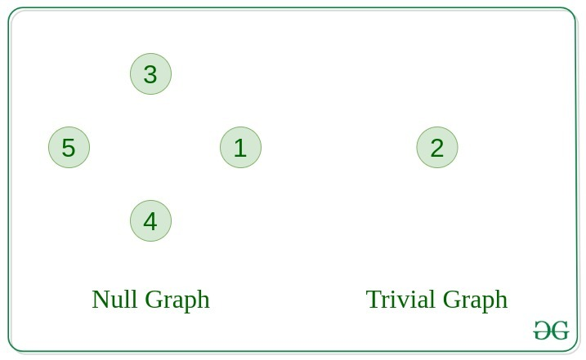
TYPES OF GRAPH
Null Graph
A graph is known as a null graph if there are no edges in the graph.
Trivial Graph
Graph having only a single vertex, it is also the smallest graph possible

Slide 11
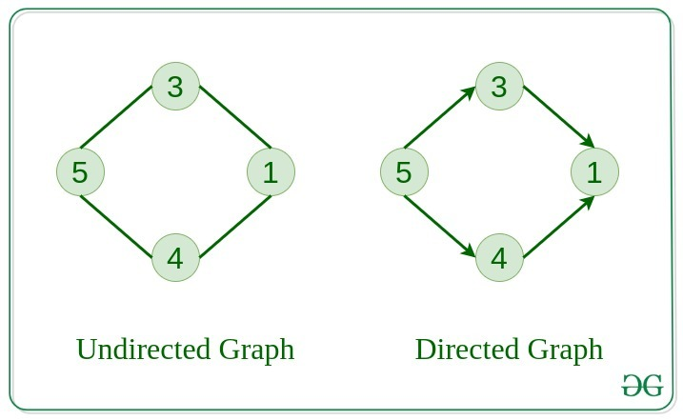
Undirected Graph
A graph in which edges do not have any direction. That is the nodes are unordered pairs in the definition of every edge.
Directed Graph
A graph in which edge has direction. That is the nodes are ordered pairs in the definition of every edge.

Slide 12
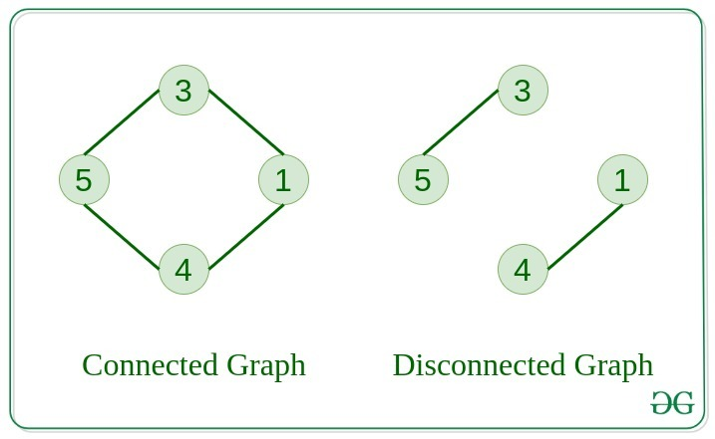
Connected Graph
The graph in which from one node we can visit any other node in the graph is known as a connected graph.
Disconnected Graph
The graph in which at least one node is not reachable from a node is known as a disconnected graph.

Slide 13
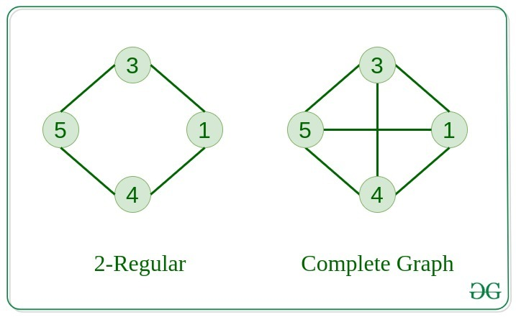
Regular Graph
The graph in which the degree of every vertex is equal to K is called K regular graph.
Complete Graph
The graph in which from each node there is an edge to each other node.

Slide 14
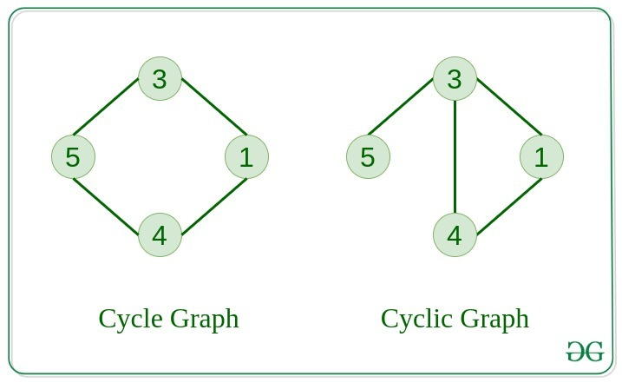
Cycle Graph
The graph in which the graph is a cycle in itself, the degree of each vertex is 2.
Cyclic Graph
A graph containing at least one cycle is known as a Cyclic graph.

Slide 15
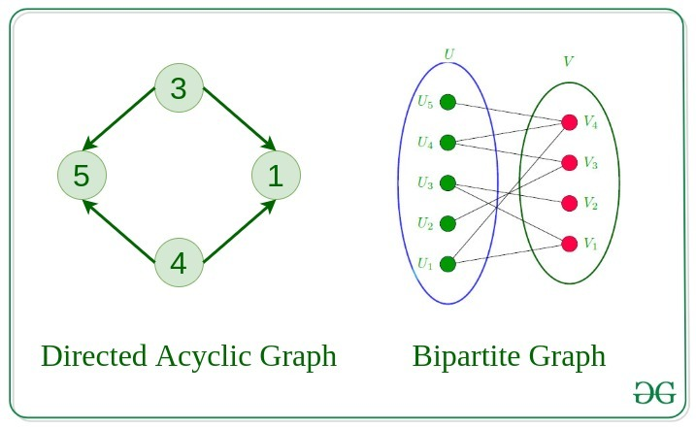
Directed Acyclic Graph
A Directed Graph that does not contain any cycle.
Bipartite Graph
A graph in which vertex can be divided into two sets such that vertex in each set does not contain any edge between them.

Slide 16
Weighted Graph
A graph in which the edges are already specified with suitable weight is known as a weighted graph.
Weighted graphs can be further classified as directed weighted graphs and undirected weighted graphs.

Slide 17
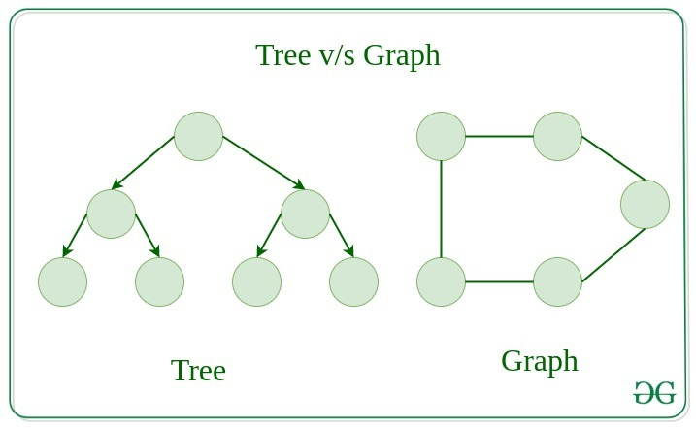
Tree v/s Graph
Trees are the restricted types of graphs, just with some more rules. Every tree will always be a graph but not all graphs will be trees. Linked List, Trees, and Heaps all are special cases of graphs.

Slide 18
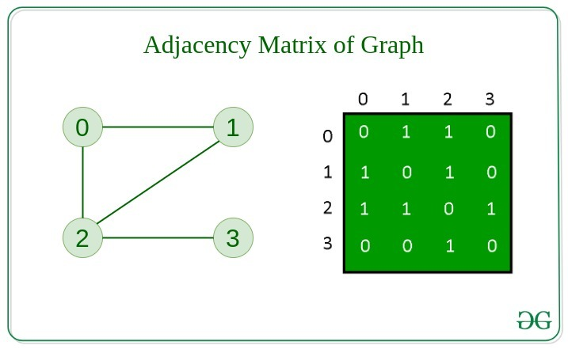
REPRESENTATION OF GRAPHS
There are two ways to store a graph:
Adjacency Matrix
Adjacency List
Adjacency Matrix
In this method, the graph is stored in the form of the 2D matrix where rows and columns denote vertices. Each entry in the matrix represents the weight of the edge between those vertices.

Slide 19
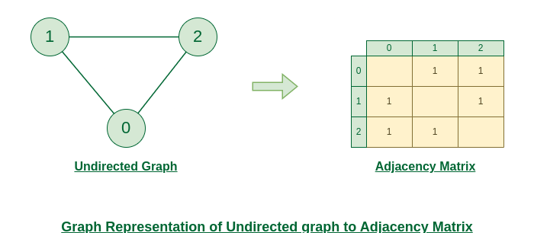

Slide 20
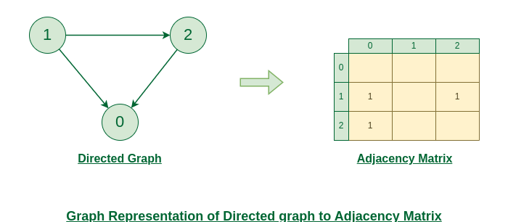

Slide 21
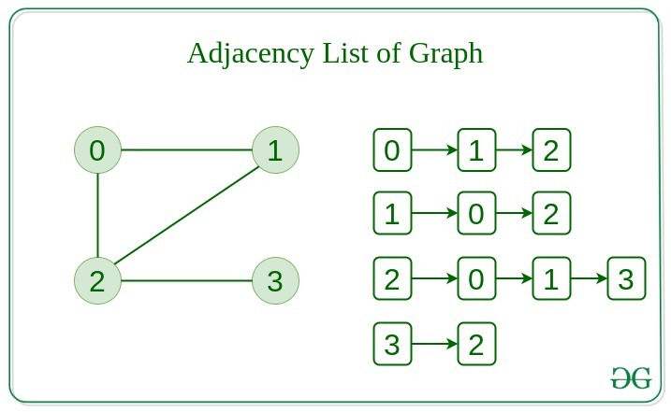
Adjacency List
This graph is represented as a collection of linked lists. There is an array of pointer which points to the edges connected to that vertex.

Slide 22
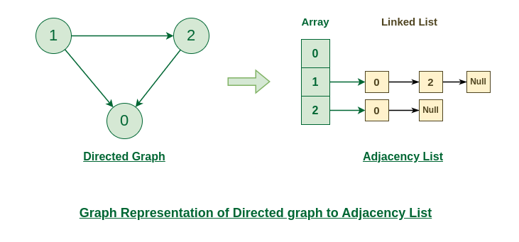

Slide 23
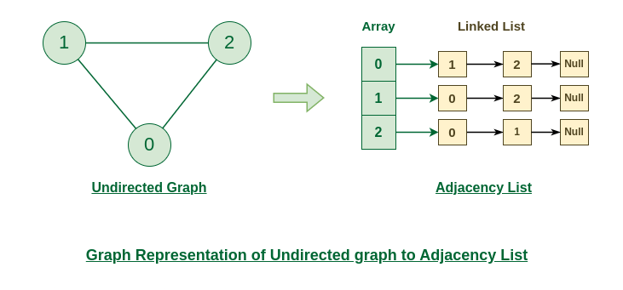

Slide 24
Basic Operations on Graphs
Below are the basic operations on the graph:
Insertion of Nodes/Edges in the graph – Insert a node into the graph.
Deletion of Nodes/Edges in the graph – Delete a node from the graph.
Searching on Graphs – Search an entity in the graph.
Traversal of Graphs – Traversing all the nodes in the graph.
Usage of graphs
Maps can be represented using graphs and then can be used by computers to provide various services like the shortest path between two cities.
When various tasks depend on each other then this situation can be represented using a Directed Acyclic graph and we can find the order in which tasks can be performed using topological sort.
State Transition Diagram represents what can be the legal moves from current states. In-game of tic tac toe this can be used.

Slide 25
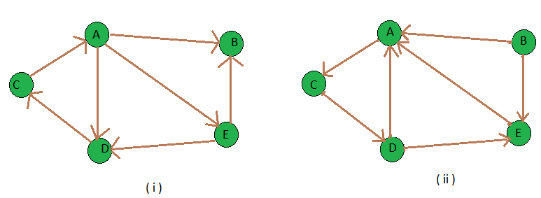
Transpose graph
Transpose of a directed graph G is another directed graph on the same set of vertices with all of the edges reversed compared to the orientation of the corresponding edges in G. That is, if G contains an edge (u, v) then the converse/transpose/reverse of G contains an edge (v, u) and vice versa. Given a graph (represented as adjacency list), we need to find another graph which is the transpose of the given graph.

Slide 26
Real-Time Applications of Graph:
Social media analysis: Social media platforms generate vast amounts of data in real-time, which can be analyzed using graphs to identify trends, sentiment, and key influencers. This can be useful for marketing, customer service, and reputation management.
Network monitoring: Graphs can be used to monitor network traffic in real-time, allowing network administrators to identify potential bottlenecks, security threats, and other issues. This is critical for ensuring the smooth operation of complex networks.
Financial trading: Graphs can be used to analyze real-time financial data, such as stock prices and market trends, to identify patterns and make trading decisions. This is particularly important for high-frequency trading, where even small delays can have a significant impact on profits.
Internet of Things (IoT) management: IoT devices generate vast amounts of data in real-time, which can be analyzed using graphs to identify patterns, optimize performance, and detect anomalies. This is important for managing large-scale IoT deployments.
Autonomous vehicles: Graphs can be used to model the real-time environment around autonomous vehicles, allowing them to navigate safely and efficiently. This requires real-time data from sensors and other sources, which can be processed using graph algorithms.
Disease surveillance: Graphs can be used to model the spread of infectious diseases in real-time, allowing health officials to identify outbreaks and implement effective containment strategies. This is particularly important during pandemics or other public health emergencies.
The best example of graphs in the real world is Facebook. Each person on Facebook is a node and is connected through edges. Thus, A is a friend of B. B is a friend of C, and so on.

Slide 27
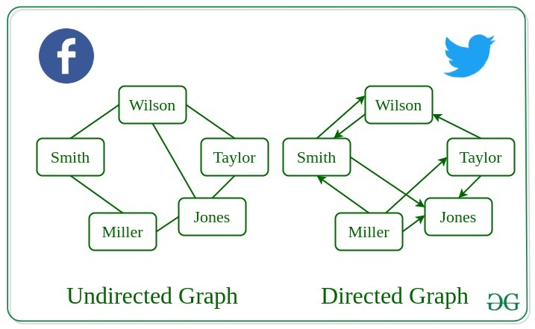
Real-Life Applications of Graph

Slide 28
Advantages:
Graphs are a versatile data structure that can be used to represent a wide range of relationships and data structures.
They can be used to model and solve a wide range of problems, including pathfinding, data clustering, network analysis, and machine learning.
Graph algorithms are often very efficient and can be used to solve complex problems quickly and effectively.
Graphs can be used to represent complex data structures in a simple and intuitive way, making them easier to understand and analyze.
Disadvantages:
Graphs can be complex and difficult to understand, especially for people who are not familiar with graph theory or related algorithms.
Creating and manipulating graphs can be computationally expensive, especially for very large or complex graphs.
Graph algorithms can be difficult to design and implement correctly, and can be prone to bugs and errors.
Graphs can be difficult to visualize and analyze, especially for very large or complex graphs, which can make it challenging to extract meaningful insights from the data.

Slide 29
BFS AND DFS IN GRAPH

Slide 30
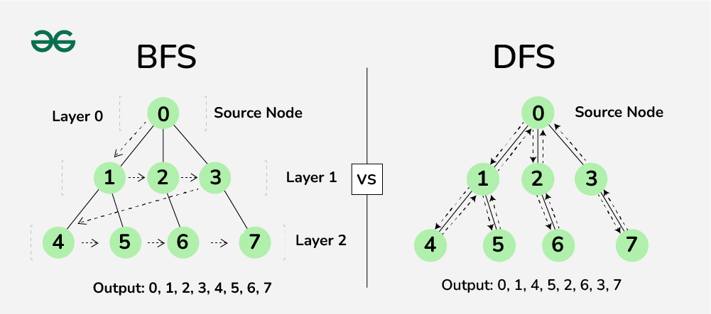
Difference between BFS and DFS

Slide 31
Depth First Search or DFS for a Graph
Depth First Traversal (or DFS) for a graph is similar to Depth First Traversal of a tree. The only catch here is, that, unlike trees, graphs may contain cycles (a node may be visited twice). To avoid processing a node more than once, use a boolean visited array. A graph can have more than one DFS traversal.
Input: n = 4, e = 6
0 -> 1, 0 -> 2, 1 -> 2, 2 -> 0, 2 -> 3, 3 -> 3
Output:
DFS from vertex 1 : 1 2 0 3
DFS Diagram:

Slide 32
Iterative Depth First Traversal of Graph
Input: n = 4, e = 6
2 -> 0, 0 -> 2, 1 -> 2, 0 -> 1, 3 -> 3, 1 -> 3
Output:
DFS from vertex 2 : 2 0 1 3
Algorithm:
Created a stack of nodes and visited array.
Insert the root in the stack.
Run a loop till the stack is not empty.
Pop the element from the stack and print the element.
For every adjacent and unvisited node of current node,mark the node and insert it in the stack.
Implementation of Iterative DFS:
This is similar to BFS, the only difference is queue is replaced by stack.
DFS Diagram:

Slide 33
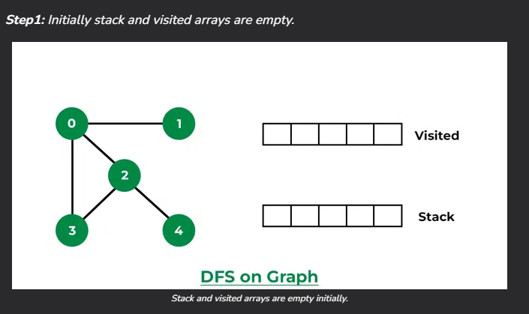
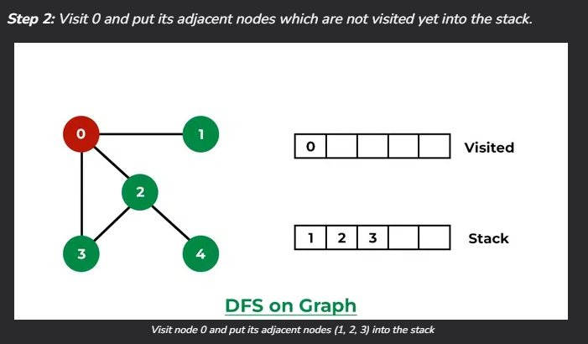
How does DFS work?
Depth-first search is an algorithm for traversing or searching tree or graph data structures. The algorithm starts at the root node (selecting some arbitrary node as the root node in the case of a graph) and explores as far as possible along each branch before backtracking.
Let us understand the working of Depth First Search with the help of the following illustration:

Slide 34
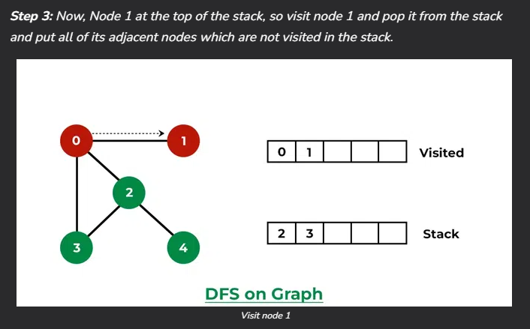
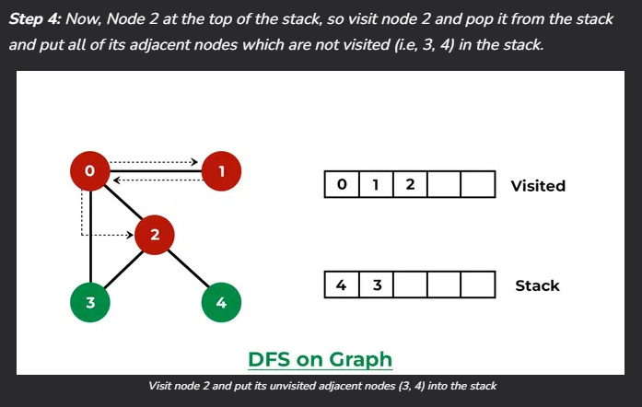
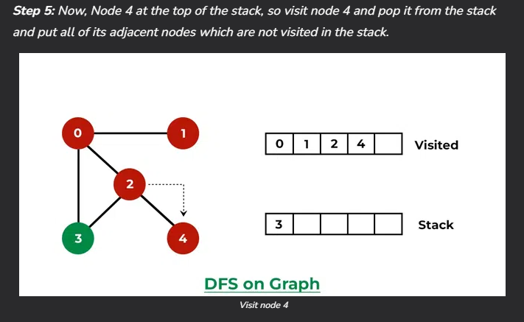
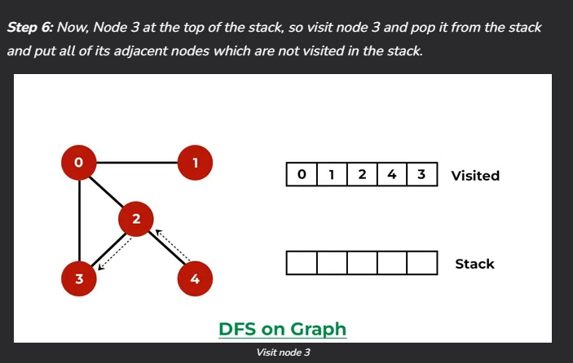

Slide 35
Applications of Depth First Search:
Detecting cycle in a graph: A graph has a cycle if and only if we see a back edge during DFS. So we can run DFS for the graph and check for back edges.
Path Finding: We can specialize the DFS algorithm to find a path between two given vertices u and z.
Call DFS(G, u) with u as the start vertex.
Use a stack S to keep track of the path between the start vertex and the current vertex.
As soon as destination vertex z is encountered, return the path as the contents of the stack
Topological Sorting: Topological Sorting is mainly used for scheduling jobs from the given dependencies among jobs. In computer science, applications of this type arise in instruction scheduling, ordering of formula cell evaluation when recomputing formula values in spreadsheets, logic synthesis, determining the order of compilation tasks to perform in makefiles, data serialization, and resolving symbol dependencies in linkers.
To test if a graph is bipartite: We can augment either BFS or DFS when we first discover a new vertex, color it opposite its parents, and for each other edge, check it doesn’t link two vertices of the same color. The first vertex in any connected component can be red or black.

Slide 36
Finding Strongly Connected Components of a graph: A directed graph is called strongly connected if there is a path from each vertex in the graph to every other vertex. (See this for DFS-based algo for finding Strongly Connected Components)
Solving puzzles with only one solution: such as mazes. (DFS can be adapted to find all solutions to a maze by only including nodes on the current path in the visited set.).
Web crawlers: Depth-first search can be used in the implementation of web crawlers to explore the links on a website.
Maze generation: Depth-first search can be used to generate random mazes.
Model checking: Depth-first search can be used in model checking, which is the process of checking that a model of a system meets a certain set of properties.
Backtracking: Depth-first search can be used in backtracking algorithms.

Slide 37
Breadth First Search or BFS for a Graph
The Breadth First Search (BFS) algorithm is used to search a graph data structure for a node that meets a set of criteria. It starts at the root of the graph and visits all nodes at the current depth level before moving on to the nodes at the next depth level.
Relation between BFS for Graph and Tree traversal:
Breadth-First Traversal (or Search) for a graph is similar to the Breadth-First Traversal of a tree.
The only catch here is, that, unlike trees, graphs may contain cycles, so we may come to the same node again. To avoid processing a node more than once, we divide the vertices into two categories:
Visited and
Not visited.
A boolean visited array is used to mark the visited vertices. For simplicity, it is assumed that all vertices are reachable from the starting vertex. BFS uses a queue data structure for traversal.

Slide 38
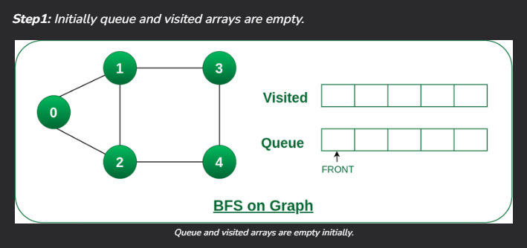
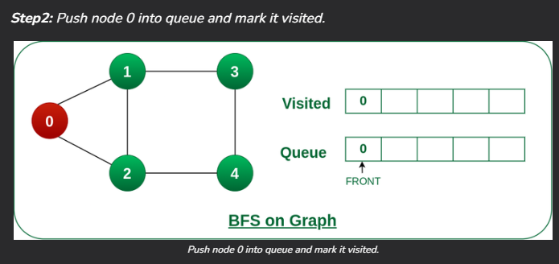
How does DFS work?
Starting from the root, all the nodes at a particular level are visited first and then the nodes of the next level are traversed till all the nodes are visited.
To do this a queue is used. All the adjacent unvisited nodes of the current level are pushed into the queue and the nodes of the current level are marked visited and popped from the queue.
Illustration:
Let us understand the working of the algorithm with the help of the following example

Slide 39
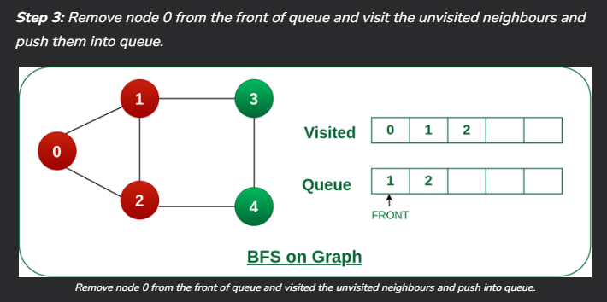
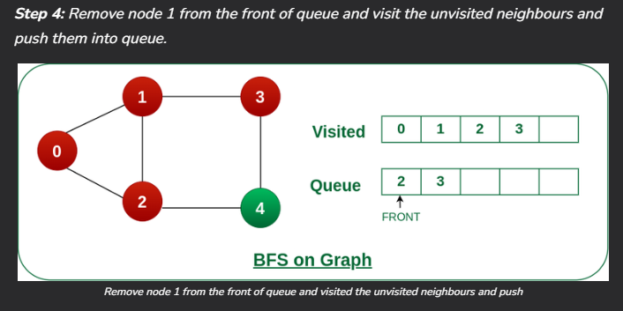
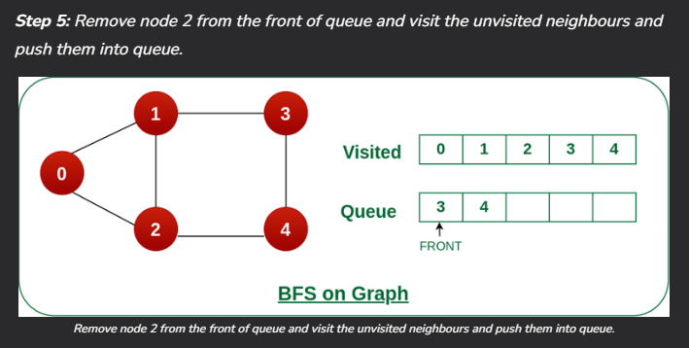
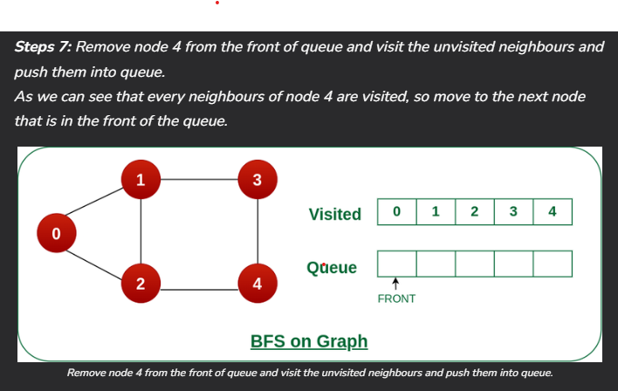
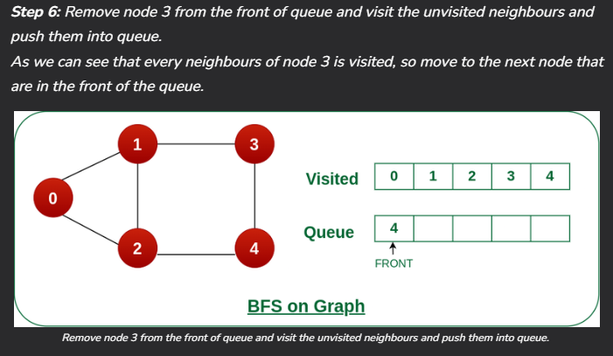

Slide 40
Applications of Breadth First Search:
Shortest Path and Minimum Spanning Tree for unweighted graph: In an unweighted graph, the shortest path is the path with the least number of edges. With Breadth First, we always reach a vertex from a given source using the minimum number of edges. Also, in the case of unweighted graphs, any spanning tree is Minimum Spanning Tree and we can use either Depth or Breadth first traversal for finding a spanning tree.
Minimum Spanning Tree for weighted graphs: We can also find Minimum Spanning Tree for weighted graphs using BFT, but the condition is that the weight should be non-negative and the same for each pair of vertices.
Peer-to-Peer Networks: In Peer-to-Peer Networks like BitTorrent, Breadth First Search is used to find all neighbor nodes.
Crawlers in Search Engines: Crawlers build an index using Breadth First. The idea is to start from the source page and follow all links from the source and keep doing the same. Depth First Traversal can also be used for crawlers, but the advantage of Breadth First Traversal is, the depth or levels of the built tree can be limited.
Social Networking Websites: In social networks, we can find people within a given distance ‘k’ from a person using Breadth First Search till ‘k’ levels.

Slide 41
GPS Navigation systems: Breadth First Search is used to find all neighboring locations.
Broadcasting in Network: In networks, a broadcasted packet follows Breadth First Search to reach all nodes.
In Garbage Collection: Breadth First Search is used in copying garbage collection using Cheney’s algorithm. Breadth First Search is preferred over Depth First Search because of a better locality of reference.
Cycle detection in undirected graph: In undirected graphs, either Breadth First Search or Depth First Search can be used to detect a cycle. We can use BFS to detect cycle in a directed graph also.
Ford–Fulkerson algorithm In Ford – Fulkerson algorithm, we can either use Breadth First or Depth First Traversal to find the maximum flow. Breadth First Traversal is preferred as it reduces the worst-case time complexity to O(VE2).
To test if a graph is Bipartite: We can either use Breadth First or Depth First Traversal.
Path Finding: We can either use Breadth First or Depth First Traversal to find if there is a path between two vertices.
Finding all nodes within one connected component: We can either use Breadth First or Depth First Traversal to find all nodes reachable from a given node.

Slide 42
AI: In AI, BFS is used in traversing a game tree to find the best move.
Network Security: In the field of network security, BFS is used in traversing a network to find all the devices connected to it.
Connected Component: We can find all connected components in an undirected graph.
Topological sorting: BFS can be used to find a topological ordering of the nodes in a directed acyclic graph (DAG).
Image processing: BFS can be used to flood-fill an image with a particular color or to find connected components of pixels.
Recommender systems: BFS can be used to find similar items in a large dataset by traversing the items’ connections in a similarity graph.
Other usages: Many algorithms like Prim’s Minimum Spanning Tree and Dijkstra’s Single Source Shortest Path use structures similar to Breadth First Search.

Slide 43
Shortest Path in Graph:
Dijkstra’s shortest path algorithm
Bellman–Ford Algorithm
Floyd Warshall Algorithm
Johnson’s algorithm for All-pairs shortest paths
Dial’s Algorithm
Karp’s minimum mean (or average) weight cycle algorithm

Slide 44
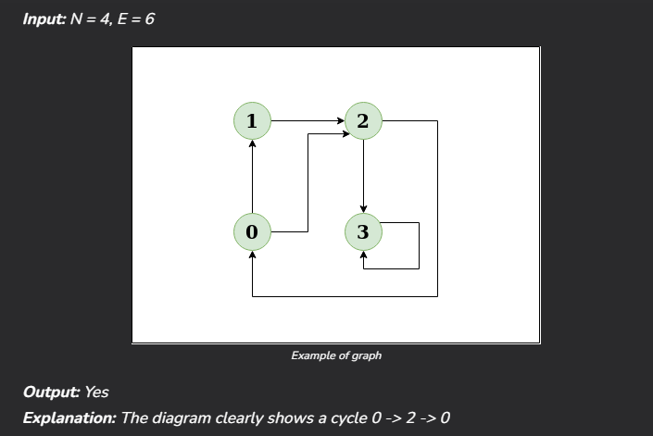
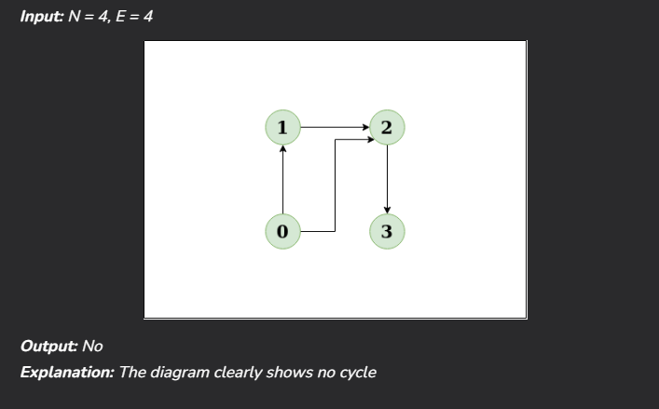
Detect Cycle in a Directed Graph

Slide 45
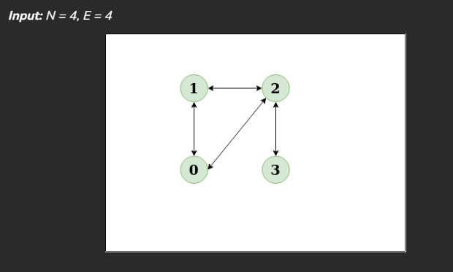
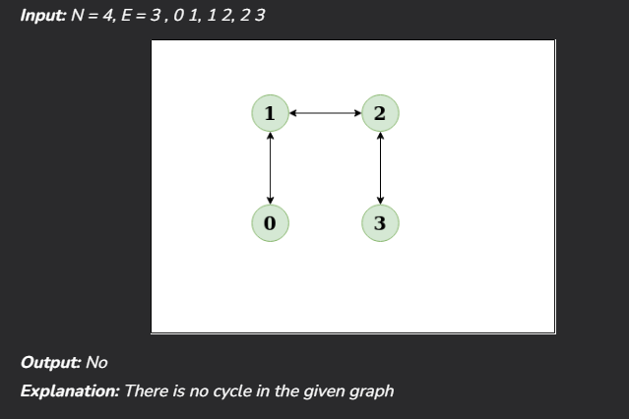

Detect Cycle in a UnDirected Graph

Slide 46
Network Analysis
What is Network?
A network is a collection of interconnected entities or nodes that can communicate or exchange information with one another. Networks can be found in many different contexts, including social, technological, and biological systems.
In a social network, the nodes might be individuals, and the connections between them might represent relationships such as friendship, family ties, or professional collaboration. In a technological network, the nodes might be devices such as computers or smartphones, and the connections between them might represent internet or cellular connections. In a biological network, the nodes might be cells or proteins, and the connections between them might represent chemical or physical interactions.
Networks can be characterized by the type of connections they have, the number of nodes they contain, and the patterns of connectivity between the nodes. Network analysis is a method of studying the relationships between the nodes in a network and understanding how the network functions as a whole.

Slide 47
What is network analysis?
Network analysis is a method of studying the relationships between entities in a network. It involves analyzing the connections, or links, between the entities, as well as the characteristics of the entities themselves. Network analysis can be used to study a wide range of systems, including social networks, transportation networks, and biological networks.
In social network analysis, for example, the entities might be individuals, and the links might represent relationships such as friendship or professional collaboration. By analyzing the patterns of relationships between individuals in a social network, it may be possible to identify key influencers, detect the spread of ideas or behaviors, or understand how groups are organized.
In transportation networks, the entities might be airports or train stations, and the links might represent flights or train routes. Network analysis can be used to identify the most efficient routes between destinations or to identify bottlenecks or other issues that may affect the performance of the network.
Many tools and techniques are available for network analysis, including graph theory, centrality measures, and network visualization methods. These tools allow researchers to identify patterns and trends in the data and understand the structure and function of the network.

Slide 48
Why Network Analysis?
Network analysis is a powerful tool for understanding the structure and function of complex systems. It allows researchers to identify patterns and trends in the relationships between the entities in a network and to understand how these relationships influence the behavior of the system as a whole.
There are many reasons why researchers might want to conduct network analysis, including:
Identifying key influencers: In a social network, for example, network analysis can be used to identify the individuals who have the most connections and are likely to have the greatest influence on the spread of ideas or behaviors.
Understanding the spread of information: Network analysis can be used to study the flow of information through a network, such as how an idea or rumor spreads through a social network.
Identifying bottlenecks or vulnerabilities: In a transportation network, network analysis can be used to identify bottlenecks or other congestion points that may affect the network’s performance.
Analyzing the structure of a network: Network analysis can be used to study the organization of a network, including the patterns of connectivity between the nodes and the overall structure of the network.

Slide 49
What are the types of network analysis?
Topological analysis: This type of analysis focuses on the overall structure of a network, including the number and types of nodes and the connections between them.
Centrality analysis: This type of analysis looks at how central or important a particular node is within a network. There are several measures of centrality, including degree centrality (the number of connections a node has), betweenness centrality (the number of shortest paths that pass through a node), and eigenvector centrality (the importance of a node based on the importance of its neighbors).
Community detection: This type of analysis aims to identify groups or communities within a network. There are several methods for detecting communities, including modularity optimization and spectral clustering.
Influence analysis: This type of analysis looks at how the actions or opinions of one or more nodes in a network can influence the actions or opinions of other nodes.
Flow analysis: This type of analysis looks at the flow of resources, information, or other quantities through a network.
Dynamics analysis: This type of analysis looks at how networks change over time, including the formation and dissolution of connections between nodes.
Resilience analysis: This type of analysis looks at the ability of a network to withstand disruptions or failures, and how it can recover from such events.
Predictive analysis: This type of analysis uses data from a network to make predictions about future events or outcomes.

Slide 50
How do you analyze the network?
Data collection
Data preparation
Data visualization
Statistical analysis
Interpretation

Slide 51
Which tool is used for network analysis?
There are many tools that can be used for network analysis, depending on the specific needs and goals of the analysis. Some popular tools include:
Gephi: Gephi is an open-source network visualization and analysis software that can be used to analyze and visualize complex networks. It offers a range of features for visualizing and analyzing networks, including layout algorithms, dynamic filtering, and community detection.
NetworkX: NetworkX is a Python library for analyzing and manipulating complex networks. It provides tools for generating and manipulating network structures, as well as algorithms for analyzing network data.
Pajek: Pajek is a software tool for analyzing and visualizing large networks. It offers a range of features for visualizing and analyzing networks, including layout algorithms, community detection, and centrality measures.
Cytoscape: Cytoscape is a network visualization and analysis software that is specifically designed for biological network analysis. It offers a range of features for visualizing and analyzing networks, including layout algorithms, dynamic filtering, and community detection.
NodeXL: NodeXL is a free, open-source tool for analyzing and visualizing networks. It is a plugin for Microsoft Excel that allows users to import and analyze network data directly within Excel.
igraph: igraph is a network analysis library for the R programming language. It provides a range of tools for generating and manipulating network structures and algorithms for analyzing network data.

Slide 52
ALGORITHM

Slide 53
Graph Creation:
A graph G is created using the NetworkX library. Edges are added to the graph using the add_edges_from method.
Fixed Node Positions:
Node positions are determined using the spring layout algorithm from NetworkX and stored in the variable ‘pos’. This layout algorithm attempts to minimize the number of edge crossings and overlap
between nodes.
Breadth-First Search (BFS):
The bfs function performs a Breadth-First Search traversal on the graph.
It takes two arguments: graph and start.
It initializes an empty set visited to keep track of visited nodes and a queue queue with the start node.
While the queue is not empty, it dequeues a node.
If the dequeued node is not visited, it marks the node as visited, prints the node, adds its neighbors to the queue, and updates the visualization by drawing the graph with highlighted visited nodes.

Slide 54
Breadth-First Search for Shortest Path:
The ‘bfs_path’ function finds the shortest path between two nodes using ‘Breadth-First Search’.
It takes three arguments: ‘graph’, ‘start’, and ‘end’.
It initializes an empty set visited to keep track of visited nodes and a queue ‘queue’ with a tuple containing the start node and a list containing only the start node.
While the queue is not empty, it dequeues a node and its path.
If the dequeued node is the destination node (end), it returns the shortest path to reach that node.
Otherwise, it marks the node as visited, adds its neighbors to the queue along with their respective paths, and updates the visualization by drawing the graph with highlighted visited nodes.
Depth-First Search (DFS):
The ‘dfs’ function performs a Depth-First Search traversal on the graph.
It takes three arguments: graph, start, and an optional visited set (used for recursion).
If the visited set is not provided, it initializes an empty set.
It starts by adding the start node to the visited set and prints the current node.
It then recursively explores each neighbor of the current node that has not been visited and updates the visualization by drawing the graph with the current node highlighted.

Slide 55
Visualization:
Visualization is performed using Matplotlib and NetworkX's drawing functions.
During BFS traversal and finding the shortest path, the graph is drawn with nodes highlighted in red for visited nodes and blue for unvisited nodes.
The plt.pause(1) function pauses the visualization for 1 second after each step to allow for visualization of the traversal process.
plt.clf() clears the current figure after each step of the traversal to avoid overlapping visualizations.
Main Execution:
The main execution section calls BFS, BFS for finding the shortest path, and DFS functions with specified start and end nodes. It then prints the shortest path returned by the BFS for finding the shortest path algorithm.

Slide 56
FLOWCHART

Slide 57
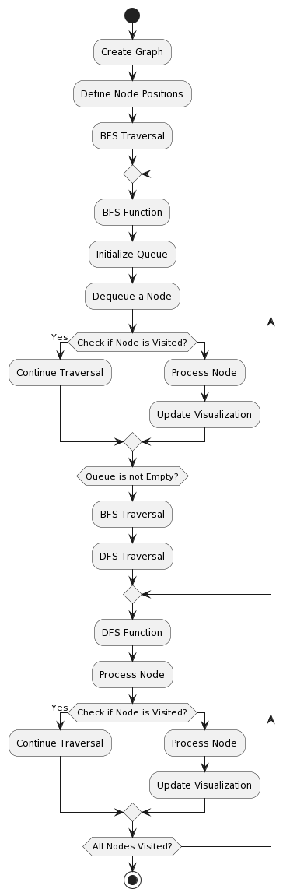

Slide 59
IMPLEMENTATION

Slide 60
import networkx as nx
import matplotlib.pyplot as plt
# Create a graph
G = nx.Graph()
G.add_edges_from([(1,2),(2,3),(3,4),(3,5),(4,6),(6,7),(2,8),(8,9),(9,4)])
# Fixed position of nodes using spring layout
pos = nx.spring_layout(G)
# Breadth-First Search (BFS)
def bfs(graph, start):
visited = set()
queue = [start]
while queue:
node = queue.pop(0)
if node not in visited:
visited.add(node)
print(node, end=' ')
neighbors = graph.neighbors(node) # get a neighbors
queue.extend(neighbors)
# Visualization: Highlight the visited node
nx.draw(graph, pos=pos, with_labels=True, node_color=['red' if n == node else 'skyblue' for n in graph.nodes()], node_size=700)
plt.title('BFS Traversal')
plt.pause(1)
plt.clf()

Slide 61
# Breadth-First Search Shortest Path(BFS)
def bfs_path(graph, start, end):
visited = set()
queue = [(start, [start])]
while queue:
node, path = queue.pop(0)
if node not in visited:
if node == end:
return path
visited.add(node)
neighbors = graph.neighbors(node)
for neighbor in neighbors:
if neighbor not in visited:
queue.append((neighbor, path + [neighbor]))
# Visualization: Highlight the visited node
nx.draw(graph, pos=pos, with_labels=True, node_color=['red' if n == node else 'skyblue' for n in graph.nodes()], node_size=700)
plt.title('SHORTEST PATH')
plt.pause(1)
plt.clf()
return None

Slide 62
# Depth-First Search (DFS)
def dfs(graph, start, visited=None):
if visited is None:
visited = set()
visited.add(start)
print(start, end=' ')
# Visualization: Highlight the visited node
nx.draw(graph, pos=pos, with_labels=True, node_color=['red' if n == start else 'skyblue' for n in graph.nodes()], node_size=700)
plt.title('DFS Traversal')
plt.pause(1)
plt.clf()
for neighbor in graph.neighbors(start):
if neighbor not in visited:
dfs(graph, neighbor, visited)
print("BFS Traversal:")
bfs(G, 1) # Start BFS from node 1
print()
print("SHORTEST PATH:")
bfs_path = bfs_path(G, 1, 8) # Start BFS from node 1 to find shortest path to node 7
print("Shortest Path from (START node) to (END node):", bfs_path)
print("\n\nDFS Traversal:")
dfs(G, 1) # Start DFS from node 1

Slide 63
END

